Slide 1

SETP
Overview
Notes:
This presentation is intended for prospective members of SETP to provide an outline on the Society. It is a basis for the President’s Annual State of the Society when appropriately tailored for specific items of interest to the membership.

Slide 2
Beginnings
Autumn 1955
  First meetings in the Antelope Valley high desert, mostly industry pilots
Spring 1956
  Incorporated in the US State of California, 65 Charter Members, around 100 Members
Fall 1957
  First Awards Banquet, The Beverly Hilton, 650 attendees
Spring 1958
  First “Subordinate” Section, Texas, later absorbed into current Southwest
Fall 1958
  First symposium, 3 days, “Professional Pilots’ Symposium on Air Space Safety”
Old SETP History Video
Notes:
A history book of our first 20 years was published in 1978 and our early archives are intact and being preserved for further study. These are some general key milestones.

Slide 3
Vision and Mission
SETP Vision
  To be the recognized world leader in promoting safety, communication and education in the design & flight test of aerospace vehicles and their related systems. To maintain a viable professional and prestigious international society for all test pilots and aerospace corporations.
SETP Mission
  Broaden professional relationships through the sharing of ideas and experiences which promote and enhance safety, communication and education.
  Prevent accidents and loss of life by improving safety, design and flight test of aerospace vehicles and their related systems.
  Provide a forum to disseminate information to those in the aerospace industry for the benefit of all aviation users.
Notes:
Promoting safety, communication and education for all test pilots.
Our Mission is most readily accomplished through our gatherings, so wide participation in those events is key to success.

Slide 4
Code of Professional Ethics
Integrity
Hold paramount the safety, health, and welfare of the end-user, passenger, and public.
Deliver accurate results and objective conclusions.
Reject bribery, fraud, and corruption in all forms, including conflicts of interest.
Properly credit the contributions of others.
Treat all persons fairly, based solely upon their words and deeds.
Excellence
Advocate for safety in the balance of flight test program risks.
Seek, accept, and offer honest criticism.
Incorporate lessons-learned into future practice, and share them when appropriate.
Steadfastly seek—and willingly provide—education and mentorship.
Accountability
Consider aptitude and proficiency before accepting tasks.
Ensure sound test pilot opinion is provided where relevant.
Acknowledge and constructively address errors.
Notes:
Added in 2020 upon realizing that such should exist, the Code of Professional Ethics has been well received across industry and organizations who have modeled similar guidelines.

Slide 5
Organization
SETP Scholarship Foundation Board of Trustees
SETP Board of Directors
SETP Foundation Board of Directors
Judging Committee
S&B Committee
Elected
Officers
President
Chairperson
Executive Director
Special Election Committee
Nominating Committee
President
Elect
Executive
Adviser
Professional Staff
Finance Committee
Treasurer
Vice
President
Legal Committee
Legal
Officer
Secretary
Annual Awards Committee
Constitution and SOP Committee
Appointed Members
Membership Committee
Fellows Coordinating Committee
Section Representatives (10)
Technical Advisers (2)
Publications Committee
Critical Incident Response Committee
Individuals
Geographical Section (10) Officers
Groups
Notes:
The volunteer elected President can conduct business on behalf of the Society, along with the paid Executive Director. The SETP Board of Directors is in charge, and the President is the Chairman of that Board. The SETP Foundation and the SETP Scholarship Foundation are separate, independent entities, with only the acceptance of Directors and Trustees falling to the SETP Board. SETP standing committees are listed, more exist under the Foundations or as required.

Slide 6
Geographical Sections
Title | Charter Date
East Coast | 7/30/1959
Central | 3/20/1963
Southwest | 3/17/1965
Europe | 6/13/1970
Southeast | 1/20/1983
Northwest | 2/23/1995
Great Lakes | 11/17/1995
West Coast | 9/18/2004
Canadian | 4/23/2009
Indian | 4/22/2021
Notes:
Regional units called sections are critical to conducting the gatherings that achieve our Mission. Each is required to hold an annual election of officers and to hold four annual meetings. For this they get a vote on the Board of Directors and funding from the SETP treasury.

Slide 7

International Organization
Australia
Austria
Belgium
Brazil
Canada
China
Czech Republic
Denmark
Finland
France
Germany
Greece
India
Indonesia
Israel
Italy
Japan
Korea
Netherlands
New Zealand
Norway
Qatar
Russia
Singapore
Slovenia
South Africa
Spain
Sweden
Switzerland
Thailand
Turkey
Ukraine
United Arab Emirates
United Kingdom
United States
Members representing these countries
Notes:
While chartered in the USA and headquartered in Lancaster, CA out of history and inertia, SETP has grown to be an international organization. Making it more internationally representative requires participation of individuals around the world.

Slide 8
Membership Data
As of September 2022
Honorary Fellow | 6
Fellow | 228
Associate Fellow | 390
Member | 1452
Associate Member | 275
Prov. Associate Member* | 144
Total: | 2495
Corporate Members: | 71
* Provisional Associate Member is not a grade, rather a temporary recognition of potential new Associate Members and Members.
Notes:
Membership seems to be peaking around 2,500. Without new, younger members this number is expected to decline in the next decade.

Slide 9
SETP Foundation
SETPF Vision
  To support the Society of Experimental Test Pilots by providing flight test education, mentoring our youth, promoting flight test safety, and preserving flight test history.
Supports SETP by:
  Providing flight test education and youth mentoring; Education/Mentoring Committee
  Promoting flight test safety; joint Flight Test Safety Committee
  Preserving SETP and flight test history; Historical Committee
Notes:
The SETP Foundation is an independently incorporated organization with very little oversight of the Parent Organization, SETP. Their Board of Directors runs the show within their bylaws. All SETP Presidents are assigned as voting members, not the Chairman, for a standard 3 year tenure.

Slide 10
SETP Scholarship Foundation
Provides educational assistance to children and families of deceased or disabled Society members and living member’s children
  $3.9M Total awards given to date
  183 Students of deceased members from 8 Countries assisted : Canada, France, Indonesia, Israel, New Zealand, Russia, South Africa, USA
  $280K distributed among 79 living member’s eligible children
This benefit extends to the families all SETP members, regardless of member’s cause of death or disability
Notes:
The Society is the parent organization of the SETP Scholarship Foundation, but by design and law has very little control. Their Board of Trustees are in charge and any overlap with SETP leadership is coincidental. The primary purpose of the Scholarship Foundation is to receive, acquire, manage, administer and expend property and funds for scholarships and other forms of educational assistance to children and families of deceased or disabled Society members. Excess funds have been granted to the children of living members.

Slide 11
Financial Statuses
SETP
  Financially sound with adequate cash reserves
  $965K in unrestricted net assets
SETP Scholarship Foundation
  Fair Market Value = $7.2M
SETP Foundation
  Good financial shape
  $98k Operating Funds (unrestricted)
  $91k Building Fund (earmarked) - $150K donated to Flight Test Historical Foundation
  $33k Flight Test Safety Committee (earmarked)
Notes:
Numbers are all good, with a renewed focus on the SETP Foundation for their building and education efforts.

Slide 12
President’s Focus/Goals 2022-23
Past
  Preserve our history through the SETP Foundation
Present
  Partnered with our sections, increase value to all members and industry
Future
  Open the path to new members with broad test backgrounds
Notes:
Brian Sandberg’s public-facing goals are summed up in supporting our past, present and future. Additional goals in these categories are focused within the Board of Directors and other SETP leadership.

Slide 13
Questions?
www.setp.org
setp@setp.org
Follow on:
LinkedIn
Facebook
Twitter
Instagram
Notes:
www.setp.org
LinkedIn
Facebook
Twitter
Instagram

Slide 14
Why Join?
Test Pilots’ only dedicated Professional Society
Access to Knowledge & Technical Support
Notes:
”Hidden Slides” for TPS Welcome to Flight Test Presentations

Slide 15
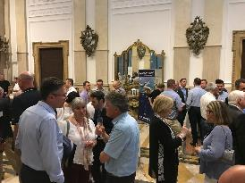
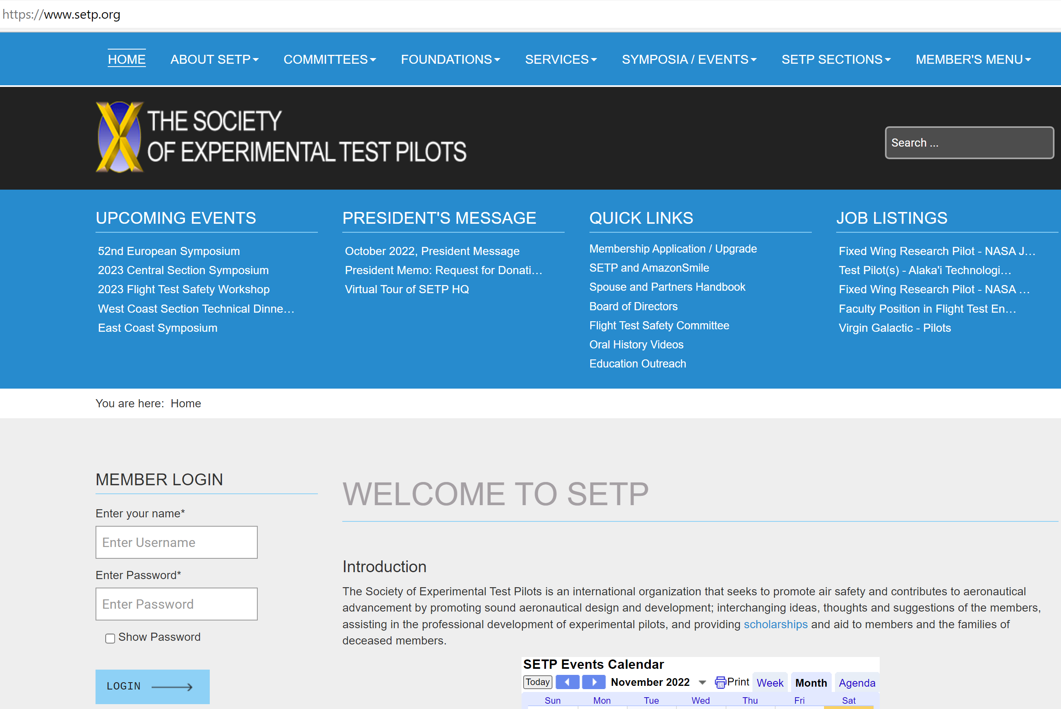
Professional Society of Test Pilots
Networking
  Direct invitation to local events
  Discounts to symposia
Industry Connectivity
  Online roster of individual and corporate members with search functions
Employment Opportunities
  Corporate and non-corporate members and non-members advertise targeted job openings
  Many hiring managers look to SETP as an insider LinkedIn
  Accessible via website

Slide 16
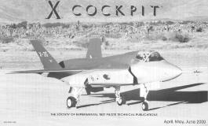

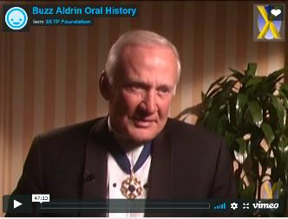
Access to Knowledge and Support
SETP Paper Data Base
  Over 1,800 papers online and searchable
  Access to SFTE member database
Video Podcasts
  Symposia presentations: 2009 and later
Oral Histories
  Continually capturing senior members
Publications
  COCKPIT Magazine
  Newsletters, e-Mail updates and misc. mailings

Slide 17
How to Join
You must be ACTIVELY ENGAGED in flight test activities for any application
  This Constitutional requirement, difficult to change, has important historical roots about who controls the Society
  Don’t postpone and regret it later!
As a new test pilot school graduate
  Join SETP immediately by submitting your provisional Associate Member (pAM) application, enjoy all Associate Member benefits
  No dues first year, Associate Member dues for year 2 and 3
  Apply for full membership within 3 years, during first test tour
    Associate Member (AM)
    Member (M)
Notes:
Again for emphasis, provisional Associate Membership is a temporary acceptance of full membership at the AM grade. It is not a lesser grade.

Slide 18
Initial Membership Grades
Associate Member (AM)
  6 months/6 qualifying flights as P/CP in Experimental or Developmental Testing
  24 months as Pilot in Production Flight Testing (6 months credit if TPS graduate)
  12 months as Pilot for Engineering Evals (6 months credit if TPS graduate)
  12 months as Pilot in Astronaut Training and TPS graduate
  Provisional Status Offered:
    Recognized Test Pilot School Graduate
    Attain Associate Member or Member criteria within 3 years and apply
    No dues first year
Member (M)
  12 months/12 qualifying flights as Pilot in Experimental or Developmental Testing
  Pilot Controlling Trajectory of Space Vehicle at least 50 miles up
Notes:
These are the entry grades. The six grades in our Constitution are Associate Member, Member, Associate Fellow, Fellow, Honorary Fellow, and Corporate. The only difference between AM and M is the ability to vote for SETP Officers or Constitutional changes, to serve on the SETP Board of Directors, or to serve as Section Chairman. All other votes, offices, and benefits are in place for AMs including those in provisional status.

Slide 19
Notes:
The form for provisional Associate Member is purposefully this simple. We want to know who you are and how to support your career. This is a temporary full membership, we expect and welcome your full participation.

