Slide 1

The Society of Experimental Test Pilots

Slide 2
History
Began on 14 September 1955 when six civilian test pilots met for lunch at a cafe near Edwards Air Force Base on California's high desert. They determined the groups should be "dedicated to assist in the development of superior aircraft."
Seventeen pilots attended the first organized meeting of the "Testy Test Pilots Society" on 29 September 1955. This name was to be short-lived, however, as it was changed to “The Society of Experimental Test Pilots” at the second meeting on 13 October 1955.
SETP History Video - Click Here

Slide 3
SETP Vision and Mission
SETP Vision
To be the recognized world leader in promoting safety, communication and education in the design & flight test of aerospace vehicles and their related systems. To maintain a viable professional and prestigious international society for all test pilots and aerospace corporations.
SETP Mission
Broaden professional relationships through the sharing of ideas and experiences which promote and enhance safety, communication and education.
Prevent accidents and loss of life by improving safety, design and flight test of aerospace vehicles and their related systems.
Provide a forum to disseminate information to those in the aerospace industry for the benefit of all aviation users.

Slide 4
Code of Professional Ethics
Integrity
Hold paramount the safety, health, and welfare of the end-user, passenger, and public.
Deliver accurate results and objective conclusions.
Reject bribery, fraud, and corruption in all forms, including conflicts of interest.
Properly credit the contributions of others.
Treat all persons fairly, based solely upon their words and deeds.
Excellence
Advocate for safety in the balance of flight test program risks.
Seek, accept, and offer honest criticism.
Incorporate lessons-learned into future practice and share them when appropriate.
Steadfastly seek—and willingly provide—education and mentorship.
Accountability
Consider aptitude and proficiency before accepting tasks.
Ensure sound test pilot opinion is provided where relevant.
Acknowledge and constructively address errors.
Notes:
Highlight in the Vision - Promoting safety, Communication and education
Our mission is really accomplished through our gatherings, symposia, regional meetings, workshops, etc so participation in those events is key to mission success

Slide 5
Membership Statistics
(EOY 2020)
Honorary Fellow | 6
Fellow | 228
Associate Fellow | 365
Member | 1465
Associate Member | 285
Provisional Associate Member | 136
Total: | 2485
Corporate Members 74

Slide 6

SETP is a Global Organization
Australia
Austria
Belgium
Brazil
Canada
China
Czech Republic
Denmark
Finland
France
Germany
Greece
Russia
Singapore
Slovenia
South Africa
Spain
Sweden
Switzerland
Thailand
Turkey
United Arab Emirates
United Kingdom
United States
India
Indonesia
Israel
Italy
Japan
Korea
Netherlands
New Zealand
Norway
Qatar

Slide 7
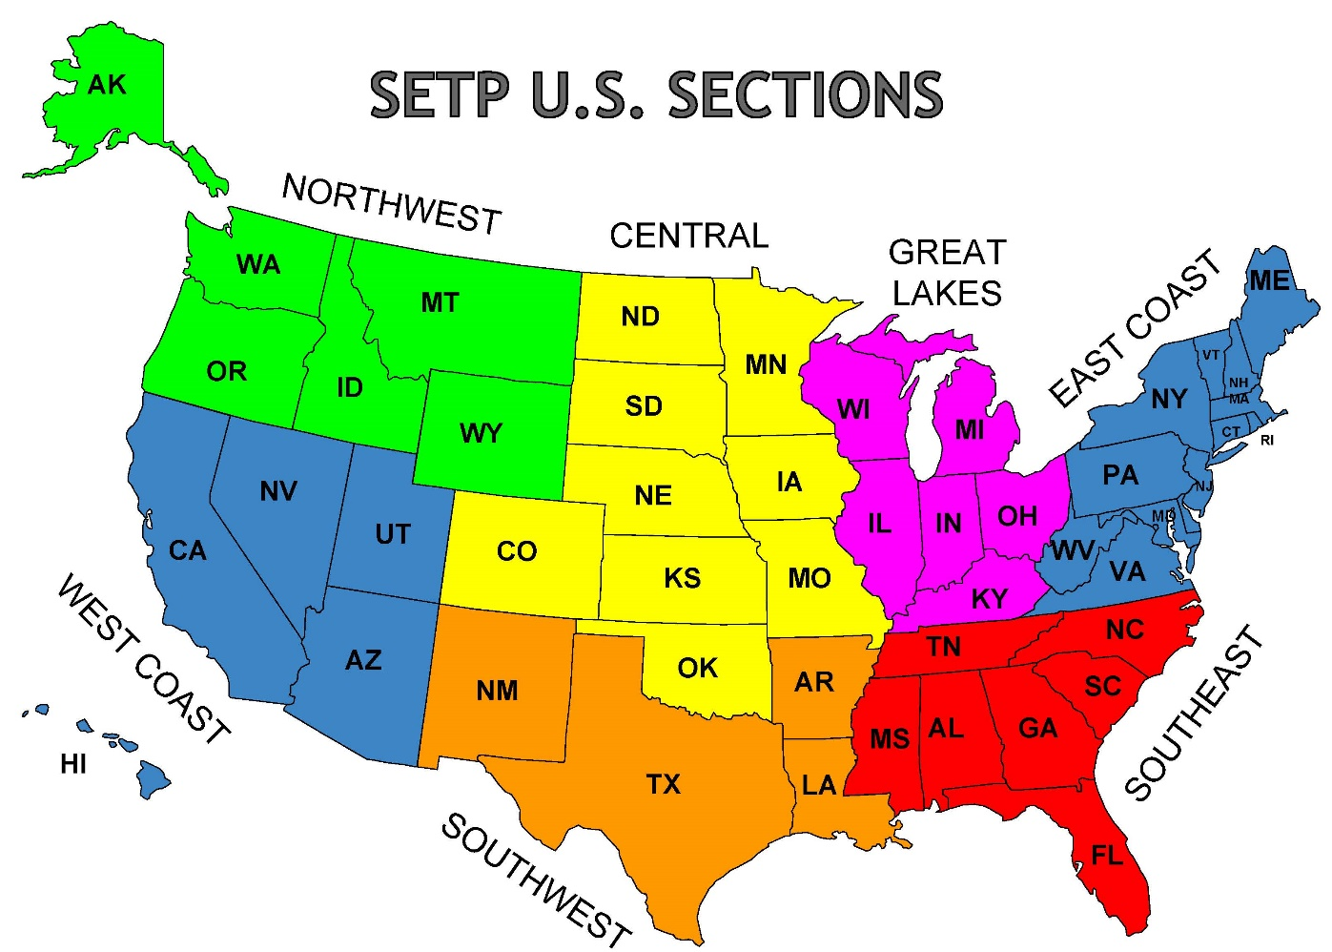
SETP Sections
SETP International Sections
European Section
Canadian Section
Indian Section

Slide 8
Benefits of Membership
Professional Society
Access to Knowledge & Tech Support
SETP Foundation
SETP Scholarship Foundation

Slide 9
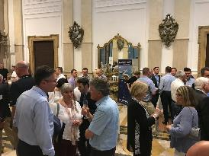
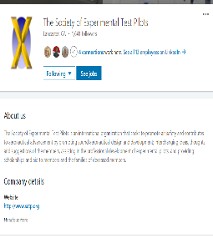
Professional Society
Networking
Industry Connectivity
  Online Roster of individual and corporate members with search functions
  Annual Symposia in US and abroad
Job Openings
  Corporate and non corporate members can advertise job openings
  Accessible via website or SETP LinkedIn page

Slide 10
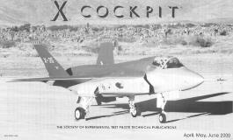
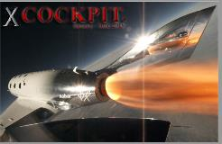
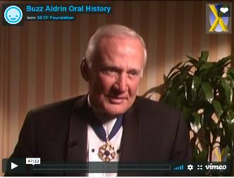
Access to Knowledge & Tech Support
  Paper Data Base
    Over 1,800 papers online and searchable
  Video Podcasts
    Symposia presentations: 2009 and later
  Oral Histories
  Publications
    COCKPIT Magazine
    Newsletters, E-Mail Updates and Misc. Mailings
  Flight Test Safety Committee
    Joint SETP, SFTE, AIAA Committee
    Flight Test Safety Fact newsletter
    Flight Test Safety Database (hosted by NASA)

Slide 11
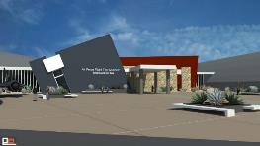
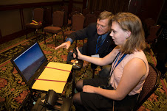
SETP Foundation
(non-profit)
Supports SETP by:
  Providing flight test education
  Youth mentoring
  Promoting flight test safety
  Preserving flight test history
USAF Flight Test Museum
Contribute through smile.amazon.com

Slide 12
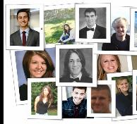
SETP Scholarship Foundation
(non-profit)
Provides educational assistance to children and families of deceased or disabled society members and living member’s children
Eligible Students:
  Attending a 2/4-Year College/University, or Vocational/Trade School
  Full-time or part-time student
  GPA ≥ 2.0 on a 4.0 Scale {C average/passing}
Funding
  Up to 100% under grad educational/vocational support to eligible students of deceased/disabled members
  Up to 100% educational/vocational support to eligible spouse/guardian of deceased/disabled members or up to 100% for their children pursuing graduate degrees
  If 1 & 2 are funded at 100%, then all eligible children under 26 of members may apply for a scholarship from any remaining of the annually allocated funds
    Application window (1/1 to 3/21)
178 students have benefited
  Currently 7 children and or spouses are receiving financial aid (U.S., Canada, U.K.).
  Anticipate >> with partial scholarships in 2021!
New
New
Contribute through smile.amazon.com
Notes:
The SETP Scholarship Foundation will fund the educational needs of the
children of our deceased and disabled members who are enrolled/attending an
accredited college, university, vocational or other trade school, in pursuit
of an undergraduate degree, certificate or license.
If the educational needs above are met at 100%, we will fund the educational
needs of the legal guardians of the children of our deceased or disabled
members, and/or the children of our deceased or disabled members in pursuit
of Graduate degrees.
There are restrictions to the above. While full-time status is not a
requirement, a satisfactory GPA is required for continued financial
assistance and the school must be accredited in accordance with our strict
guidelines.
If all of the children and legal guardians above have been fully funded at
100% of their educational expenses, and funds remain that are available for
allocation in accordance with our "Standard of Practice*, the Board of
Trustees may elect to award one-time scholarships for the upcoming academic
year to the children or wards of active SETP members.

Slide 13
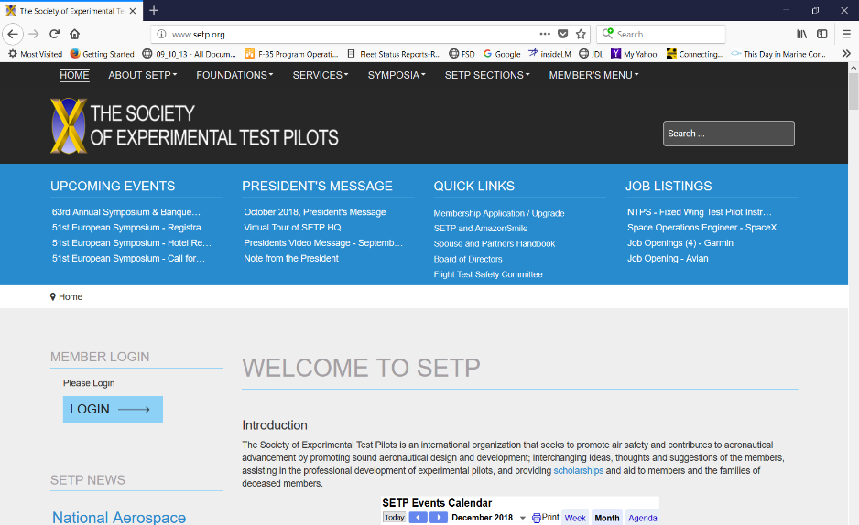
Website - www.setp.org

Slide 14
SETP Leadership
Section Representatives
Canadian Section | Perry Comeau | National Research Council for Canada
Central Section | Dan Hinson | Textron Aviation
East Coast Section | Steve Wright | KBR
European Section | Jeremy Tracy | Leonardo Helicopters (Ret)
Great Lakes Section | James Bieryla | Dept. of the Air Force
Indian Section | Subash John | Indian Air Force (Ret)
Northwest Section | Steve Crane | Allied Approach Group
Southeast Section | Glen Knaust | Lockheed Martin
Southwest Section | Tom Currie | Bell Helicopter
West Coast Section | William Koyama | Lockheed Martin
Board of Directors
PRESIDENT | David Nils Larson | NASA
PRESIDENT-ELECT | Brian Sandberg | Lockheed Martin
VICE PRESIDENT | Brett Pierson | Lockheed Martin
SECRETARY | Kelly Latimer | Virgin Galactic
TREASURER | Kerry Smith | The Boeing Company
LEGAL OFFICER | Rusty Lowry | ABSI Aerospace & Defense
Executive Advisor | Michael Wallace | The Boeing Company
Technical Advisor | Jameel Janjua | Virgin Galactic
Technical Advisor | Justin Paines | Vertical Aerospace

Slide 15
2022 Events
Southeast Section Symposium | 4 February 2022
West Coast Section Symposium | 18 March 2022
East Coast Section Symposium | 1 April 2022
Central Section Symposium | 1 April 2022
Northwest Section Symposium | 22 April 2022
Flight Test Safety Workshop | 3-5 May 2022
Great Lakes Section Symposium | 12 May 2022
52nd European Section Symposium | 18-21 May 2022
Canadian Section Symposium | 8-9 June 2022
66th Annual Symposium & Banquet | 21-24 September 2022
European Flight Test Safety Workshop | 11-13 October 2022

Slide 16
How Can I Join SETP?
You must be ACTIVELY ENGAGED in flight test activities!
  Join as soon as you can, don’t postpone!
As a new Test Pilot School Graduate
  Join SETP immediately by submitting your Provisional Associate Member (PAM) application
You can upgrade later, when eligible, as either
  Associate Member (AM)
  Member (M)

Slide 17
Membership Grades
Provisional Associate Member
  Recognized Test Pilot School Graduate
  Attain Associate Member/Member Criteria Within 3 Years
  No dues first year
Associate Member
  6 months/6 qualifying flights as P/CP in Experimental or Developmental Testing
  24 months as Pilot in Production Flight Testing (6 months credit if TPS graduate)
  12 months as Pilot for Engineering Evals (6 months credit if TPS graduate)
  12 months as Pilot in Astronaut Training and TPS graduate
Member
  12 months/12 qualifying flights as P in Experimental or Developmental Testing
  Pilot Controlling Trajectory of Space Vehicle at least 50 miles up
Associate Fellow/Fellow
  “Legacy” test pilots

Slide 18
Questions?

