Slide 1
THE SOCIETY OF EXPERIMENTAL TEST PILOTS Why Join?
Test Pilots’ only dedicated Professional Society
Access to Knowledge & Technical Support

Slide 2
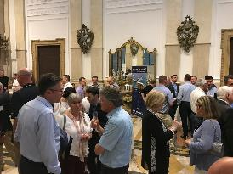
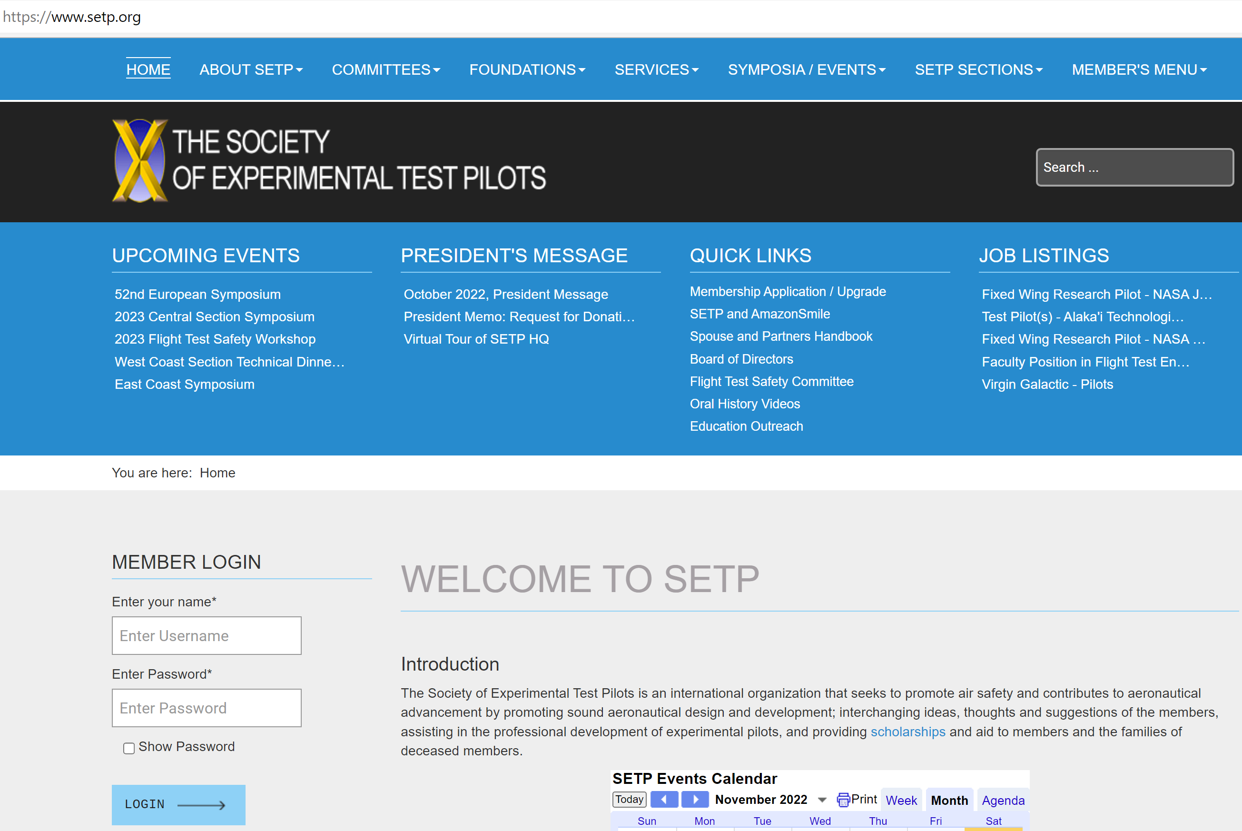
Professional Society of Test Pilots
Networking
Direct invitation to local events
Discounts to symposia
Industry Connectivity
Online roster of individual and corporate members with search functions
Employment Opportunities
Corporate and non-corporate members and non-members advertise targeted job openings
Many hiring managers look to SETP as an insider LinkedIn
Accessible via website

Slide 3
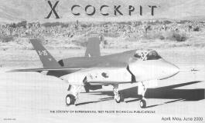
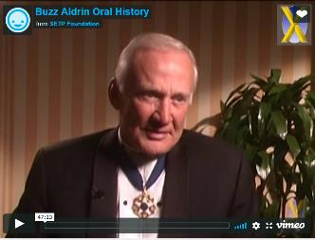
Access to Knowledge and Support
SETP Paper Data Base
Over 1,800 papers online and searchable
Access to SFTE member database
Video Podcasts
Symposia presentations: 2009 and later
Oral Histories
Continually capturing senior members
Publications
COCKPIT Magazine
Newsletters, e-Mail updates and misc. mailings

Slide 4
How to Join
You must be ACTIVELY ENGAGED in flight test activities for any application
This Constitutional requirement, difficult to change, has important historical roots about who controls the Society
Don’t postpone and regret it later!
As a new test pilot school graduate
Join SETP immediately by submitting your provisional Associate Member (pAM) application, enjoy all Associate Member benefits
No dues first year, Associate Member dues for year 2 and 3
Apply for full membership within 3 years, during first test tour
Associate Member (AM)
Member (M)
Notes:
Again for emphasis, provisional Associate Membership is a temporary acceptance of full membership at the AM grade. It is not a lesser grade.

Slide 5
Initial Membership Grades
Associate Member (AM)
6 months/6 qualifying flights as P/CP in Experimental or Developmental Testing
24 months as Pilot in Production Flight Testing (6 months credit if TPS graduate)
12 months as Pilot for Engineering Evals (6 months credit if TPS graduate)
12 months as Pilot in Astronaut Training and TPS graduate
Provisional Status Offered:
Recognized Test Pilot School Graduate
Attain Associate Member or Member criteria within 3 years and apply
No dues first year
Member (M)
12 months/12 qualifying flights as Pilot in Experimental or Developmental Testing
Pilot Controlling Trajectory of Space Vehicle at least 50 miles up

Slide 6
Questions?
www.setp.org
setp@setp.org
Follow on:
LinkedIn
Facebook
Instagram

Slide 7
MORE ABOUT SETP

Slide 8
Vision and Mission
SETP Vision
To be the recognized world leader in promoting safety, communication and education in the design & flight test of aerospace vehicles and their related systems. To maintain a viable professional and prestigious international society for all test pilots and aerospace corporations.
SETP Mission
Broaden professional relationships through the sharing of ideas and experiences which promote and enhance safety, communication and education.
Prevent accidents and loss of life by improving safety, design and flight test of aerospace vehicles and their related systems.
Provide a forum to disseminate information to those in the aerospace industry for the benefit of all aviation users.

Slide 9
Code of Professional Ethics
Integrity
Hold paramount the safety, health, and welfare of the end-user, passenger, and public.
Deliver accurate results and objective conclusions.
Reject bribery, fraud, and corruption in all forms, including conflicts of interest.
Properly credit the contributions of others.
Treat all persons fairly, based solely upon their words and deeds.
Excellence
Advocate for safety in the balance of flight test program risks.
Seek, accept, and offer honest criticism.
Incorporate lessons-learned into future practice, and share them when appropriate.
Steadfastly seek—and willingly provide—education and mentorship.
Accountability
Consider aptitude and proficiency before accepting tasks.
Ensure sound test pilot opinion is provided where relevant.
Acknowledge and constructively address errors.
Notes:
.

Slide 10
Geographical Sections
Title | Charter Date
East Coast | 7/30/1959
Central | 3/20/1963
Southwest | 3/17/1965
Europe | 6/13/1970
Southeast | 1/20/1983
Northwest | 2/23/1995
Great Lakes | 11/17/1995
West Coast | 9/18/2004
Canadian | 4/23/2009
Indian | 4/22/2021

Slide 11
International Organization
Australia
Austria
Belgium
Brazil
Canada
China
Czech Republic
Denmark
Finland
France
Germany
Greece
India
Indonesia
Israel
Italy
Japan
Korea
Netherlands
New Zealand
Norway
Qatar
Russia
Singapore
Slovenia
South Africa
Spain
Sweden
Switzerland
Thailand
Turkey
Ukraine
United Arab Emirates
United Kingdom
United States
Members representing these countries

Slide 12
Membership Data
As of December 2023
Honorary Fellow | 5
Fellow | 247
Associate Fellow | 384
Member | 1427
Associate Member | 267
Prov. Associate Member* | 150
Total: | 2480
Corporate Members: | 76
* Provisional Associate Member is not a grade, rather a temporary recognition of potential new Associate Members and Members.

Slide 13
SETP Foundation
SETPF Vision
To support the Society of Experimental Test Pilots by providing flight test education, mentoring our youth, promoting flight test safety, and preserving flight test history.
Supports SETP by:
Providing flight test education and youth mentoring; Education/Mentoring Committee
Promoting flight test safety; joint Flight Test Safety Committee
Preserving SETP and flight test history; Historical Committee

Slide 14
SETP Scholarship Foundation
Provides educational assistance to children and families of deceased or disabled Society members and living member’s children
$4.2M Total awards given to date
187 Students of deceased members from 8 Countries assisted : Canada, France, Indonesia, Israel, New Zealand, Russia, South Africa, USA
$407K distributed among 140 living member’s eligible children
This benefit extends to the families all SETP members, regardless of member’s cause of death or disability

